Slide 1
Computer Network (CS3002)
Spring Semester (2021-2022)
Dr. Judhistir Mahapatro
Department of Computer Science and Engineering
National Institute of Technology Rourkela

Slide 2
The Network Layer

Slide 3
Distance Vector Routing
Dynamic routing algorithms are more complex as compared to Flooding
  but more efficient because they find shortest paths for the current topology.

Slide 4
Distance Vector Routing
Each router maintain a table
  The best known distance to each destination
  The link to use to get the destination
These tables are updated by exchanging information with the neighbors.
Eventually, every router knows the best link to reach each destination.
Entry has two parts:
  the preferred outgoing link to use for that destination, and
  an estimate of the distance to that destination.

Slide 5
Distance Vector Routing
Router is assumed to know the distance to each of its neighbors.
If the metric is propagation delay
  ECHO packets used
Assume that delay is used as a metric and that the router knows the delay to each of its neighbors.

Slide 6
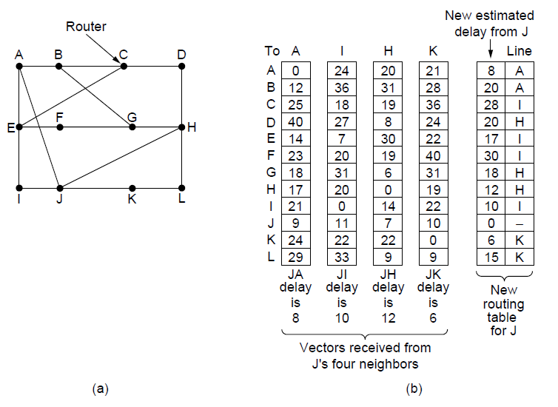

Slide 7
The Count-to-Infinity Problem
Settling of routes to best paths across the network is called Convergence.
Routers collectively compute the shortest path.
It converges to correct answer, but it may do so slowly.

Slide 8
The Count-to-Infinity Problem
It reacts rapidly to good news, but leisurely to bad news.
  Router A → X path is long, Neighbor B reports that it has a shorter delay to X then A switches the outgoing link to B for forwarding.
  Just in one vector exchange, the good news is processed.
  Good news is spreading at a rate of one hop per exchange.

Slide 9
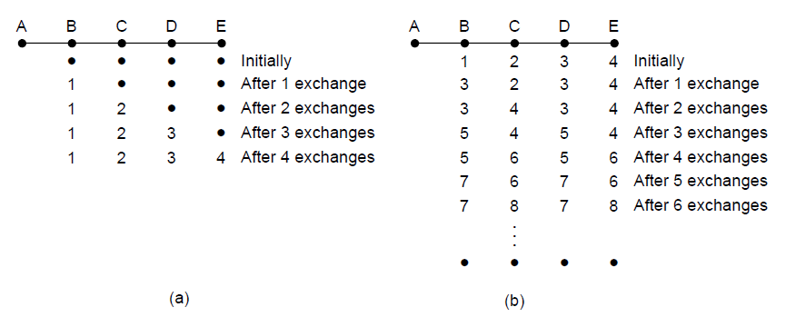
The count-to-infinity problem

Slide 10
Link State Routing
Distance Vector routing took too long to converge after the network topology changed
    due to count-to-infinity problem.
Variants of link state are IS-IS (Intermediate Station to Intermediate Station) and OSPF (Open Shortest Path First) routing algorithms
    widely used inside large networks and Internet today.

Slide 11
Link State Routing
Each router must do the following:
  Discover its neighbors, learn their network addresses.
  Set distance/cost metric to each neighbor.
  Construct packet telling all it has learned.
  Send packet to, receive packets from other routers.
  Compute shortest path to every other router.

Slide 12
Learning about Neighbors
When router is booted, its first task to learn who its neighbors are.
Sending a special HELLO packet on each point-to-point line.
  Each neighbor sends back a reply by giving its name
When two or more routers are connected by a broadcast link, the situation is slightly more complicated.

Slide 13
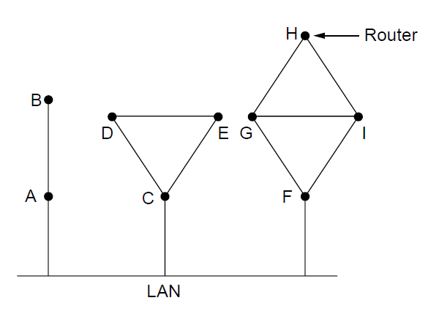
Learning about Neighbors
Nine routers and a broadcast LAN.

Slide 14
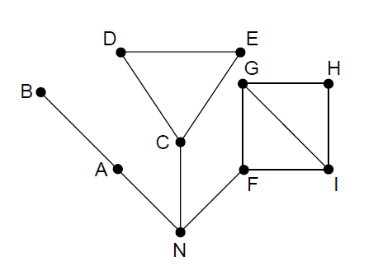
Learning about Neighbors
A graph model of the broadcast network.
One designated router on the LAN is selected to play the role of N in the routing protocol.

Slide 15
Settling link costs
Each link to have a distance or cost metric
Cost to reach neighbors can be set automatically, or configured by the network operator.
Generally, cost inversely proportional to the bandwidth of the link.
    higher-capacity paths better choices.
Delay of the links may be factored into the cost
      Echo packet may be used to estimate the delay

Slide 16
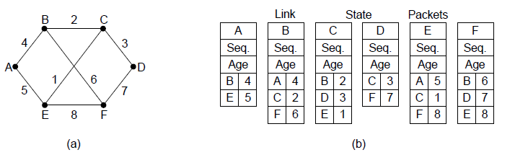
Building Link State Packets
(a) A network. (b) The link state packets
Hard part is determining when to build them.
  Build them periodically.
  Build them when some significant event occurs, such as a line or neighbor going down or coming back up again.

Slide 17
Distributing the Link State Packets
Use flooding to distribute the link state packets to all routers.
To keep the flood in check, each packet contains a sequence number.
  Routers keep track of all (source, sequence#) pair they see.
  If the packet is new then forwarded.
  If the packet is duplicate or older then discarded.
  Use a 32-bit sequence number to get rid from the problem of wrap around.

Slide 18
Distributing the Link State Packets
If a router ever crashes
  it will loose track of its sequence number.
  If starts again at 0, the next packet it sends will be rejected as a duplicate.
If sequence number received is 65,540 (ever corrupted) instead 4
  then all the packets 5 through 65,540 will be rejected.
Solutions to all these problems is Age.

Slide 19
Distributing the Link State Packets
Decrement this age once per second.
  When it hits zero, the information from the router is discarded.
  Age field is also decremented by each router during the initial flooding process,
    to make sure no packet can get lost and live for an indefinite period of time.
  packet with age zero is discarded

Slide 20
Distributing the Link State Packets
Refinement to make it more robust
  When a link state packet comes in to a router for flooding, not transmitted immediately, but put it in the holding area to see if another link state packet coming from the same source router
    If seq#s are equal, the duplicate is discarded
    If seq#s are difference, older one is thrown out
  Link state packets are acknowledged to guard against errors on the links

Slide 21
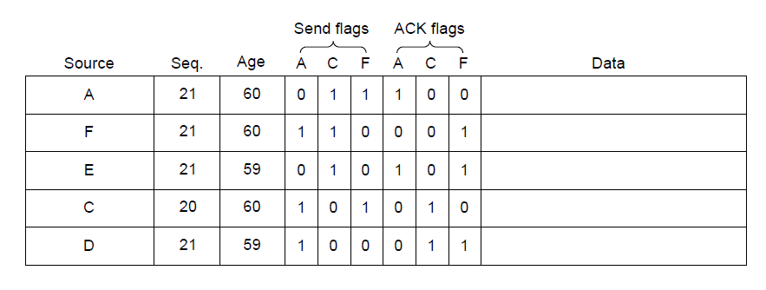
Distributing the Link State Packets
Send flags: packet must be sent on the indicated link
Ack flags: it must be acknowledged there.
The packet buffer for router B

Slide 22
Distributing the Link State Packets
Now Dijkstra’s algorithm can be run locally to construct the shortest paths to all possible destinations.
Compared to distance vector routing, if network with n routers, each has k neighbors then
  memory required would be kn,
  computation time grows faster then kn, even with more efficient data structure.

Slide 23
Hierarchical Routing
Networks grow in size, the routing tables grow proportionally.
  CPU time is needed to scan them
  More bandwidth is required to send status reports about them
  At some point it is no longer feasible for every router to have an entry for every other router
    Routing have to be hierarchically

Slide 24
Hierarchical Routing
Routers are divided into Regions
  Each router knows all details within its own region but knows nothing about internal structure of other regions
  More bandwidth is required to send status reports about them
  At some point it is no longer feasible for every router to have an entry for every other router
    Routing have to be hierarchically

Slide 25
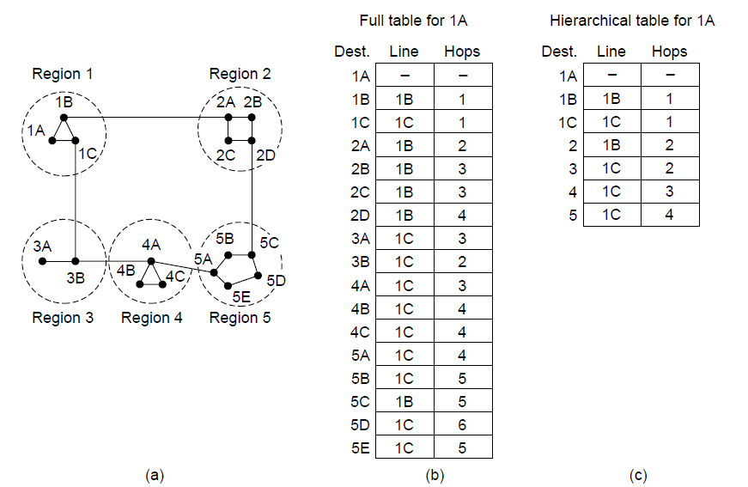
Hierarchical Routing

Slide 26
Hierarchical Routing
Let us take a network with 720 routers
  If there is no hierarchy, each router needs 720 entries
  If two-level that is into 24 regions of 30 routers each, then each router needs 53 entries
  If three-level that is into 8 clusters and 9 regions of 10 each, then 25 entries

Slide 27
Reference
Computer Networks, Fifth Edition by Andrew Tanenbaum and David Wetherall, Pearson Education-Prentice Hall, 2011

